Slide 1
project -DELIVERABLE 1
GROUP-BRAINSTORMERS

Slide 2
ON CAMPUS TIME SHEET AND PAYROLL MANAGEMENT SYSTEM

Slide 3
Contents
Motivation
Major Functions
Development Environment
Team Roles
Charts
Risk Management

Slide 4
MOTIVATION:
Student employees at universities work part-time. Students visit institutions to meet with management to discuss employment schedules. The manager allots time for the students based on their course work. At the end of the week or month, the manager calculates the hours worked and pays the appropriate amount after subtracting tax. He also records the start and end times of each day worked. All of this data is entered manually, which requires extra time and labor. We created a web based application project called On Campus Time Sheet and Payroll Management System to computerize all of these processes.

Slide 5
MAJOR FUNCTIONS:
In the website the students enrolls their details for part time job. The manager logins into the website where he allots the working hours for each student using time sheets and also see whether they are working at that hours or not. The students view their working time sheet for the week in the website and works accordingly. At the end of the week or month the project calculates working hours of each student and calculates their payments with taxes and transfer amount to their bank accounts.

Slide 6
MODULES INVOLVED IN PROJECT:
1. Admin Module
2. Manager Module
3. Student Module
4. Time sheet Module
5. Payroll Module
6. Bank Module
7. Reports Module

Slide 7
DEVELOPMENT ENVIRONMENT:
Front End Language: HTML, CSS, Java Script
Back End Database: Java(Servlets/JSP) with MySQL
Back End Language: PHP

Slide 8
TEAM ROLES:
Vaishnavi Mandadi (Group Leader)
Design of UI, Middle layer integration from backend to frontend and frontend to backend.
Kiran Jyothi Bodduluri
Design of UI, Backend Integration and E-R diagrams.
3. Sahit Reddy Chinthakuntla
Implementing UI Design, PPT , Creating Database table and Writing test files.
4. Rajashekhar Reddy Moddu
Gathering required resources, Design of UI, UML diagrams creation.

Slide 9
Team roles
5. Venkata Sai Reshma kallepalli
Design of UI, Backend Integration, Documentation and PPT.
6. Akshaya Sampelli
Design of UI, Scheduling meetings, PPT, Gantt Chart.
7. Aishwarya Yadav Jala
UI design, requirement specification, Testing, Documentation and UML diagrams.

Slide 10
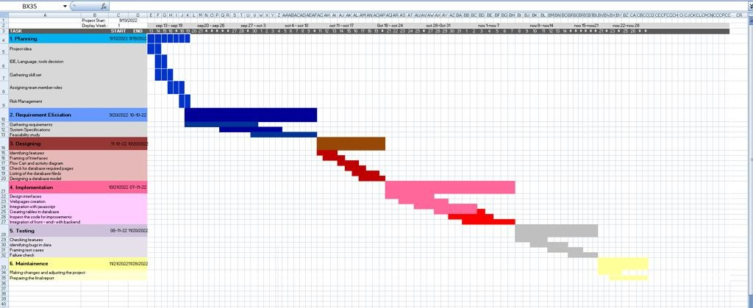
CHARTS: GANTT CHART

Slide 11
RISK MANAGEMENT:
In our group discussion while analysing the project requirements we identified the following major risks.
1. Since our project involves seven modules like Admin, Manager, Student, Time Sheet, Payroll, Bank and Reports therefore integration between these modules may involve some mistakes
2. Difficulties in implementing the proper database design for the application.
3. Developing application by group members at different timings leads to delay in achieving the tasks.

Slide 12
THANK YOU

